Slide 1
CCI Integration Meeting, ECMWF, 14-16 March 2011
Independent validation of IASI/METOP-A LMD and RAL CH₄ products using CAMS model, in situ profiles and
ground-based FTIR measurements
Bart Dils, Minqiang Zhou, Claude Camy-Peyret, Yannick Kangah, Bavo Langerock, Pascal Prunet, Carmine Serio, Cyril Crevoisier, Richard Siddans, Brian Kerridge
6-10 December 2021, Evian, France

Slide 2
CCI Integration Meeting, ECMWF, 14-16 March 2011
The IASI methane products

Slide 3
LMD (Laboratoire de Météorologie Dynamique, France)
Version number: v8.3 for METOP-A and v8.1 for METOP-B
Available via https://iasi.aeris-data.fr
Neural network (non-linear regression using a multi-layer perceptron)
No uncertainty on each individual retrieval
Combination of 4 IFOV (~ IASI field of regard FOR scale)
One integrated mid-tropospheric column value with a specific vertical sensitivity profile → mtCH₄ will be used as a notation for this value
RAL (Rutherford Appleton Laboratory, UK)
Version number: v2.0 METOP-A only
Available via https://catalogue.ceda.ac.uk
Optimal Estimation Method (OEM)
RAL selects the best (warmest brightness temperature at 950 cm⁻¹) scene out of the 4 IFOVs within one IASI FOR
Total column dry air mole fraction with corresponding averaging kernels (AK) and estimated uncertainty → XCH₄

Slide 4
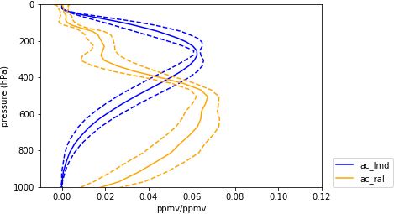
Significant differences:
retrieval methodology (neural network vs. OEM)
used spectra (best of vs. combined IFOV)
obtained product (mtCH₄ vs. XCH₄)
Reference data smoothing (sensitivity profile vs. averaging kernel)
Normalised averaging kernels for RAL XCH₄ (orange) and LMD XCH₄ (blue) globally averaged over the year 2014
${c′}_{C,adj}=\frac{\sum_{i=1}^{N}{H_{i}∆P_{i} x_{C,i}}}{\sum_{i=1}^{N}{H_{i}∆P_{i}}}$,
$c_{i}=c_{S,a}+A_{S}(x_{i}−x_{S,a})$,

Slide 5
2 distinct IASI CH₄ products
LMD
RAL
in situ:
Aircraft profiles from
HIPPO
IAGOS
Contrail
AirCore profiles from NOAA little expansion needed but sparse
Mauna Loa high altitude station → only qualitative comparison
Ground-based remote sensing FTIR data
TCCON → profile scaling retrieval: XCH₄ only. Smooth scaled a priori as a workaround
NDACC → retrieved profile but with limited vertical resolution (DOF ~ 2.1 to 2.5)
CAMS reanalysis control run
Pretty stable till 2017, but with small < 20 ppb biases of its own
Reference data smoothing (sensitivity profile vs. Averaging kernel)
Profiles need to be expanded (scaled CAMS model data)
→
→

Slide 6
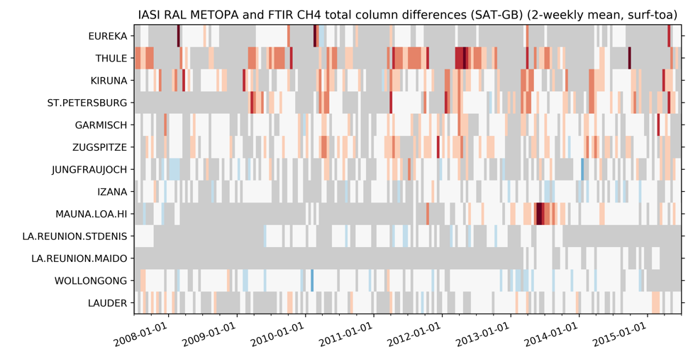
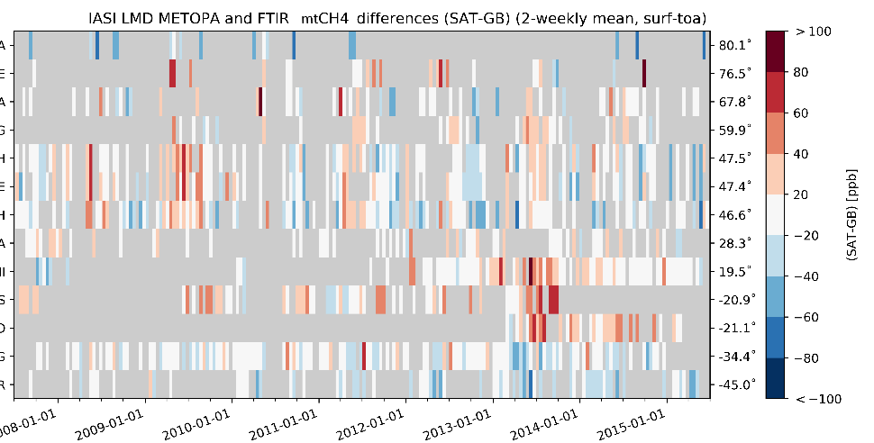
This talk = highlights only (which in a validation context are often the things that hint at points of improvement!)
May impart a negative outlook on these products
Overall both products do a good job at capturing CH₄ concentrations!!
RAL too high at high latitude LMD too high near tropics

Slide 7
CCI Integration Meeting, ECMWF, 14-16 March 2011
Direct intercomparison for CH₄ products

Slide 8
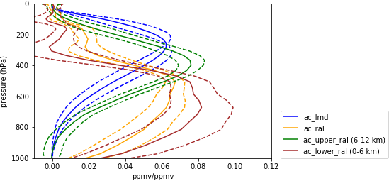
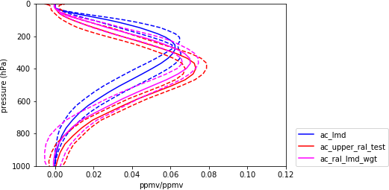
1) Select partial column range.
5-15 km partial column yielded good results
+ Independent of LMD
2) Smooth RAL using the LMD sensitivity profile
+ Slightly lower scatter in the RAL-LMD bias
8

Slide 9
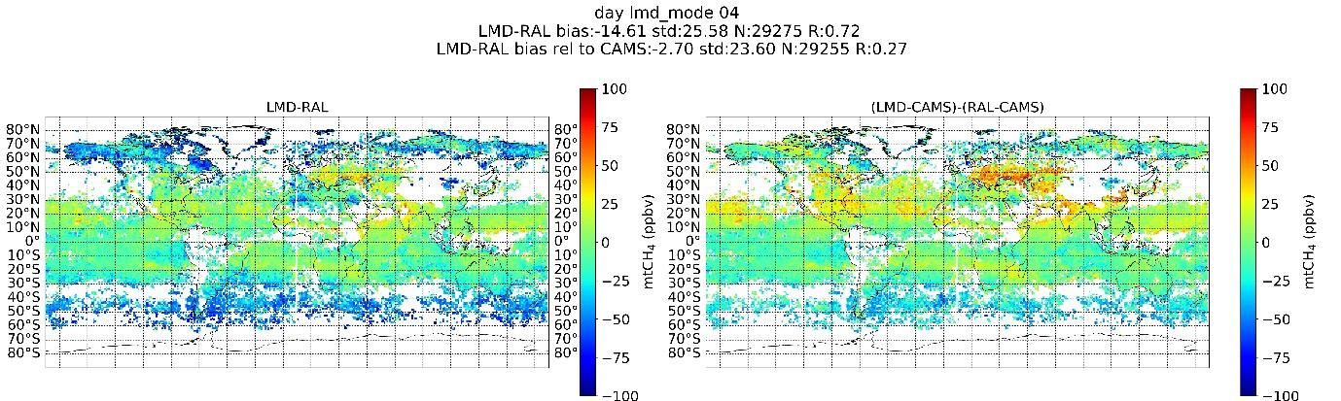
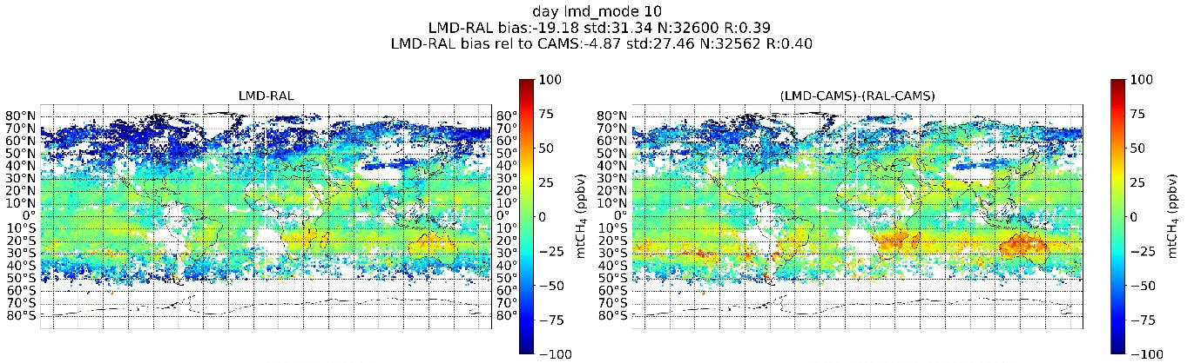
April
Negative bias at high latitudes in direct comparison
Using CAMS as an intermediate, some differences get smaller (high latitude) while others enlarge (mid latitude)
Very high negative bias at high latitudes in October?
October

Slide 10
CCI Integration Meeting, ECMWF, 14-16 March 2011
Trend & seasonality of CH₄ products

Slide 11
North
America
boreal
LMD
RAL
Europe
South
Pacific
temperate
Results for the long term trend comparison with CAMS
LMD: Seasonal cycle and trend mismatch at higher latitudes = strong seasonality in the bias! (minimum in October)
RAL: consistent trend mismatch over all regions but reasonable seasonal cycle

Slide 12
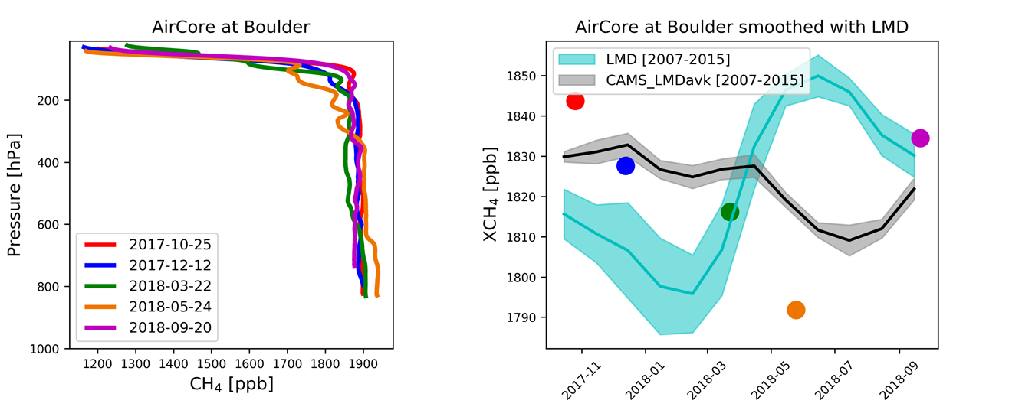
AirCore
- Stability (trend and seasonal cycle) LMD at higher latitudes?
- Robustness high latitude neural network training dataset?
- Users are advised by LMD to stick to 60°N-60°S band
- Improvements, specifically targeted at higher latitude performance, are ongoing at LMD

Slide 13
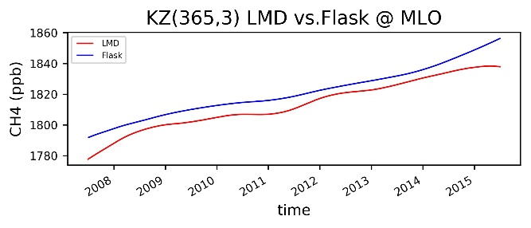
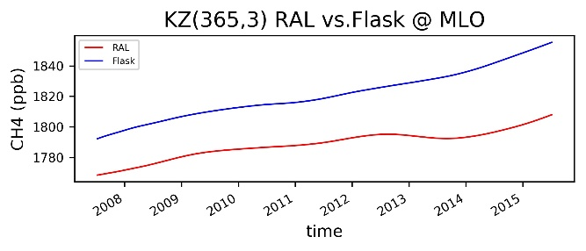
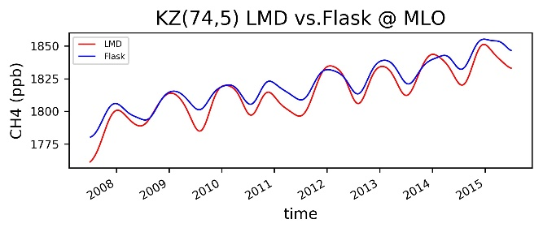
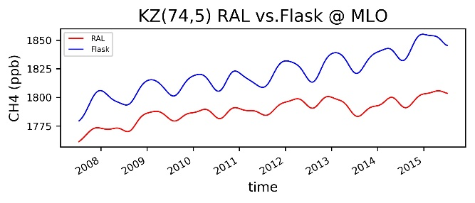
Smoothed time series @ Mauna Loa
?

Slide 14
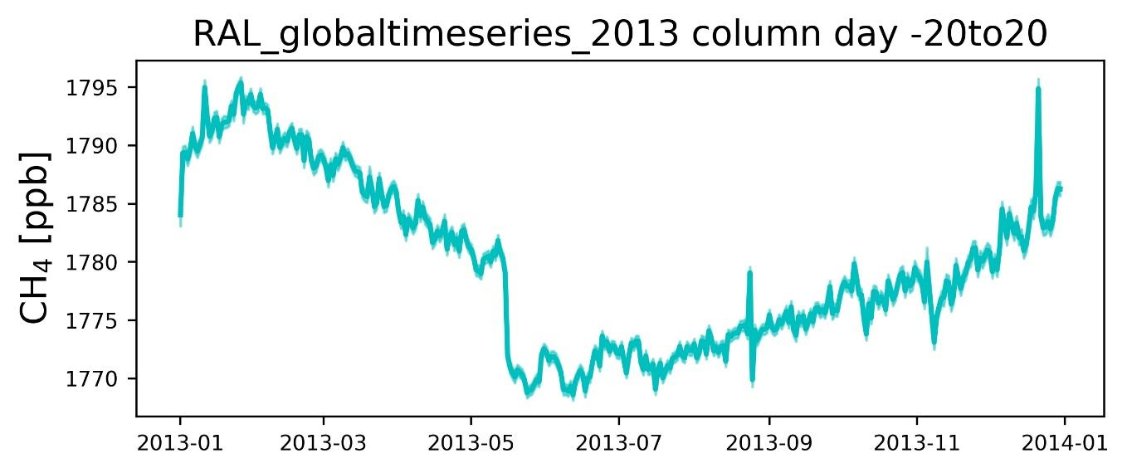
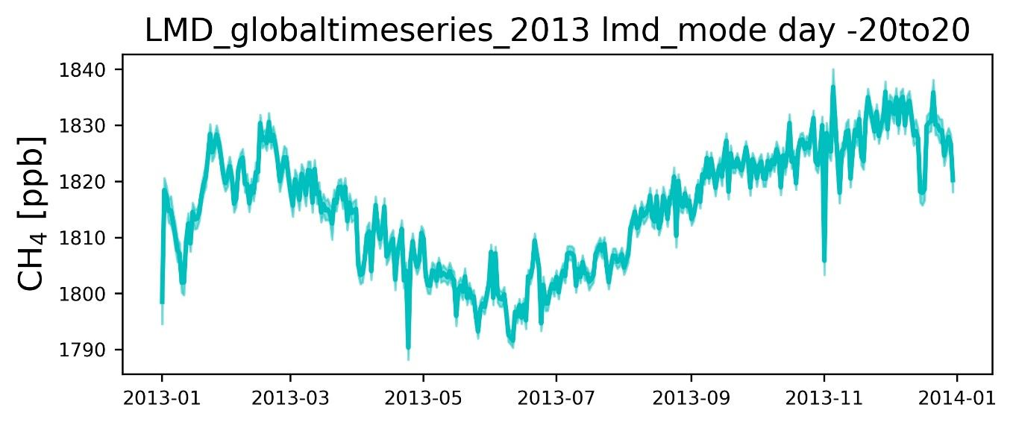
IASI L1 version change on 16th May 2013
Significant impact on RAL
No visible impact on LMD

Slide 15
CCI Integration Meeting, ECMWF, 14-16 March 2011
Vertical information from the RAL CH₄ product

Slide 16
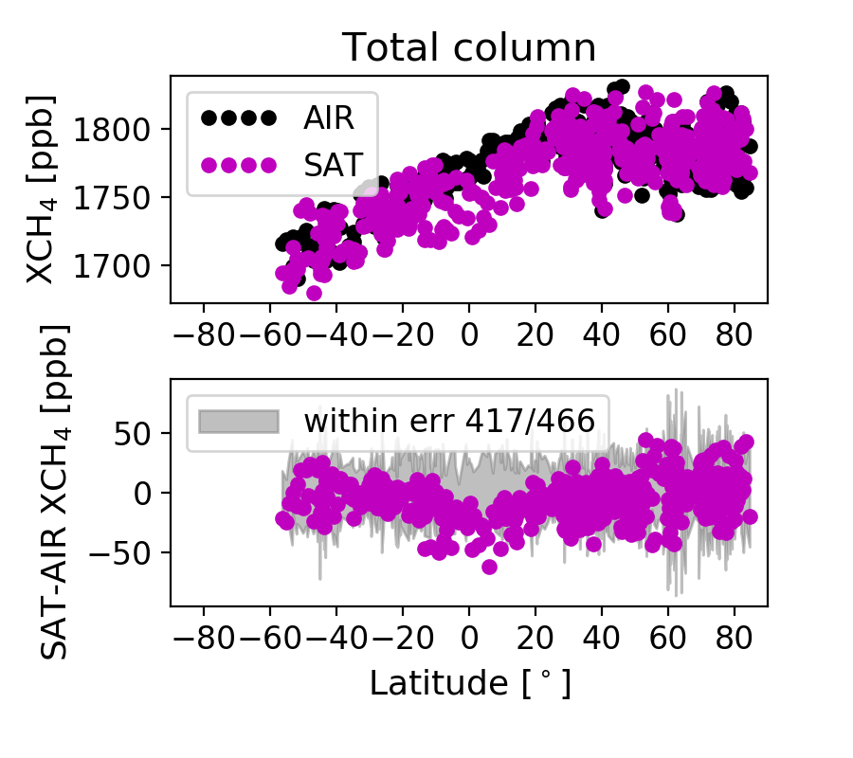
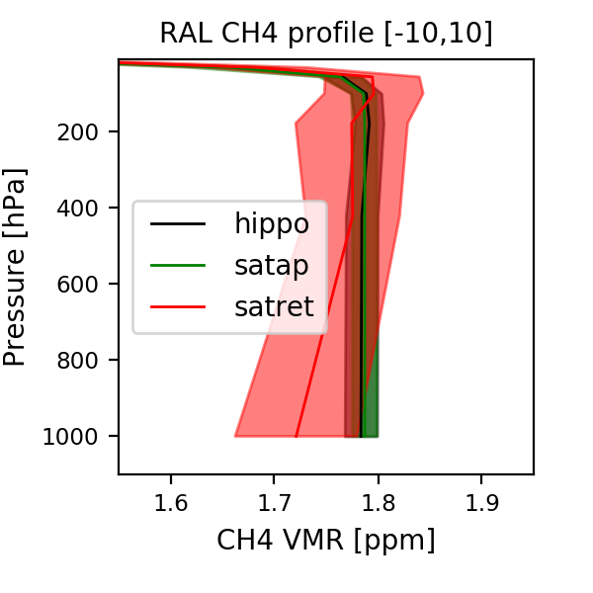
By comparing with HIPPO measurements, we find there is an about 30 ppb underestimation of RAL XCH₄ in the tropical region
The low XCH₄ RAL measurements is coming from the low value in the lower layer [0-6 km]
RAL
Unexpected profile shape

Slide 17
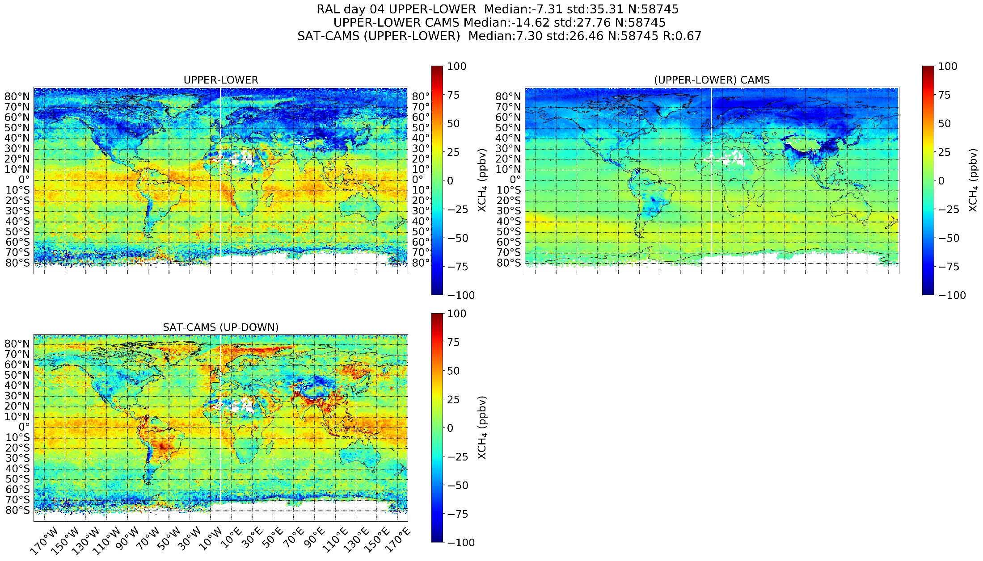
Two sub-columns
Lower = 0 – 6 km
Upper = 6 – 12 km
RAL
Upper partial column markedly higher than lower partial column in tropics
Marked abrupt difference between land and sea

Slide 18
A lot of information is provided in the RAL product, hence detailed analyses are possible. But one should not use this positive point to conclude negatively.
How can we summarize the vertical information on the CH₄ profile from RAL?
The RAL CH₄ product seems to be sensitive to the respective weights of the IASI signal and the a priori information in the retrieval process.
Is the chosen combined instrument noise + forward model error (S_{y} matrix) too small?
Has enough constraint been applied in the retrieval (S_{a} matrix)?
And are thus the reported 2 DOFs overestimated?
The RAL retrieval team is working on improvements whereby they will address potential issues without compromising their reported ability to distinguish 2 distinct partial columns.

Slide 19
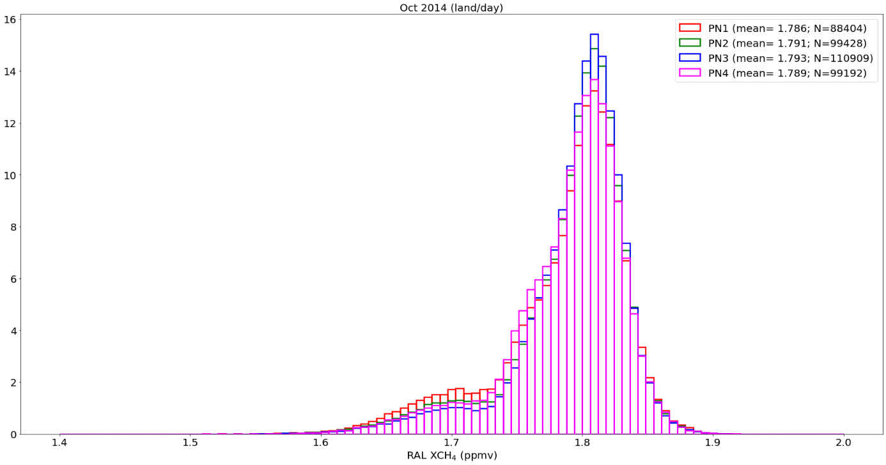
Since a lot of information is provided in the RAL products more detailed consistency checks are possible
Some differences are observed for daytime XCH₄ between pixel 3 and pixel 1 with averaged differences of about 7 ppbv over land and 8 ppbv over sea.
Significant?
RAL
The subset of IFOVs for P1 and P3
are disjoint since the best is chosen.
The histograms are given for each subset separately (the pixel index used for the retrieval is in the product)

Slide 20
CCI Integration Meeting, ECMWF, 14-16 March 2011
Conclusions on the comparison of the two CH₄ products (LMD and RAL)

Slide 21
Both products exhibit their own particular strong and weak points
RAL
Typical overestimation at high latitudes during winter-spring
Good capture of the seasonal cycle
2013 hiatus cripples the RAL long-term trend analysis capabilities
Little trend dependence as a function of latitude
a priori covariance matrix adequate with respect to noise + RTM error?
LMD
Overestimation in the (sub)tropics
Strong overestimation of the seasonal amplitude (and misrepresentation of the phase) + underestimation of the long term trend at high latitudes:
Outspoken negative bias during autumn at high latitudes at later years
Good agreement with the long-term trend (apart from high latitude regions)
Is the neural network training database robust enough for high latitude scenes?

Slide 22
CCI Integration Meeting, ECMWF, 14-16 March 2011
Acknowledgements
Thanks to EUMETSAT for funding the work within the project called VIMP.
All the data providers (NDACC, TCCON, CONTRAIL, NOAA, IAGOS, CAMS) and individuals involved in the painstaking retrieval of CH₄ data (used in this work) are to be acknowledged. Thanks to the LMD and RAL algorithm development teams for the fruitful interactions when discussing our findings.

Slide 23
Things we looked at
Direct RAL vs. LMD comparisons
Bias and scatter with respect to all model and reference measurements
Long term trend and seasonality
RAL partial column biases
Day-night differences
METOP-A vs. METOP-B differences
Interpixel differences
Scan angle differences
Impact of clouds

